Slide 1

MINI PROJECT
Introductory Seminar
On
“Bidify :- A bidding solution for Properties”
Presented by
Group No.: 17
Aarushi Dhote
Mansi Gudadhe
Pooja Zodape
Shreya Gajbhiye
Taniya Keswani
VI Semester, CSE
Superviser by
Aarti Jane
Assistant professor

Slide 2

CONTENTS
INTRODUCTION
PROBLEM STATEMENT
OBJECTIVE
LITERATURE SURVEY
METHODOLOGY
SYSTEM BLOCK DIAGRAM
IMPLEMENTATION
RESULT & DISCUSSION
REQUIREMENT
CONCLUSION
REFERENCES
Department of Computer Science & Engineering

Slide 3
INTRODUCTION
❑ Our bidding solution revolutionizes property transactions by streamlining the buying, selling, and renting processes. Sellers list their properties, setting a starting price, and potential buyers or renters engage in competitive, real-time bidding.
❑ The solution ensures transparency, allowing users to monitor bids and property details. Smart algorithms facilitate fair pricing, and a user-friendly interface simplifies navigation.
❑ Notifications keep users informed, while secure payment gateways provide a trustworthy transaction experience. With features designed for convenience and efficiency, our app transforms property transactions into a seamless and dynamic experience for both buyers and sellers
Department of Computer Science & Engineering

Slide 4
PROBLEM STATEMENT
Current landscape: Traditional property buying and selling can be slow, opaque and geographically restrictive. Buyers often lack access to a wide range of options, while sellers may struggle to reach the right audience.
Proposed solution: Develop a solution specifically designed for online bidding on properties. This platform will address the limitations of the current market by:
For buyers:
Transparency, Competitive pricing, Convenience
For sellers:
Wider reach, Efficiency, Competitive market, Streamlined process
UNIQUE FEATURE
Unique feature of our application is Biding.
❑
❑
❑
Department of Computer Science & Engineering

Slide 5
OBJECTIVE
❑
❑
Our bidding solution aims to make buying, selling, and renting properties easy and trustworthy. We want to simplify the process with a user-friendly interface, transparent bidding, and efficient notifications.
Our goal is to build trust by helping users confidently understand fair market values. We will use a smart system for quick bid processing and secure payment methods.
Overall, we aim to revolutionize property transactions by providing a reliable and user-friendly platform for everyone involved.
Department of Computer Science & Engineering

Slide 6
LITERATURE SURVEY
Sr. No. | Title | Details of Paper | Summary
[01] | Role of digital compatibility | Author by Wang and zhang published in year (2017) | Underscores the role of digital compability In extending bidding platform accessibility,considering the increasing trend of digital usage
[02] | Significance of Robust bidding | Author by Smith et al. published in the year (2018) | Enabling users to participate in competitive auctions. Existing literature highlights the importance of real-time responsiveness, security, and user experience in such platforms
[03] | Usability and interface design | Author by Kim and Lee published in the year (2021) | Emphasizing the impact of user-friendly layouts and intuitive navigation on enhancing bidder satisfaction.
Department of Computer Science & Engineering

Slide 7
LITERATURE SURVEY
Sr. No. | Title | Details of Paper | Summary
[04] | Property Management System | Author by Yomik Pandey published in the year (2023) | Real estate investors, and the property managers working on their behalf, can realize the advantages of customer-focused property management by adopting a series of straightforward best practices, which are discussed in the paper.
[05] | The value of property management services | Author Paavo Monkkonen by published in the year (2020) | Findings – Results show that property management does add value, especially to older and more dilapidated properties. Practical implications – Findings suggest that there is money to be made by high-quality companies providing services for lower quality buildings.
Department of Computer Science & Engineering

Slide 8
METHODOLOGY
Define the data structure for Seller/Buyer. This will include information like name, ID, contact details, address, etc. You can use a relational database like MySQL.
Admin will have access to all functionalities, while seller/buyer can update their own profiles.
• View all property data (list or search)
• Filter/sort property data
• Edit property data (optional)
Buyer/Seller:
• View their profile information
• Update their profile information (within specific limits)
• Application Building : We proceed to develop the frontend and backend components of the system using HTML, CSS, JAVASCRIPT, PHP and mySQL Workbench. This stage focuses on building intuitive user interfaces and robust backend functionality.
• Deployment and Maintenance: Upon successful development and testing, we deploy the system to a production environment. We continuously monitor the system's performance, provide ongoing support, and implement updates to ensure its reliability and relevance over time.
Department of Computer Science & Engineering

Slide 9
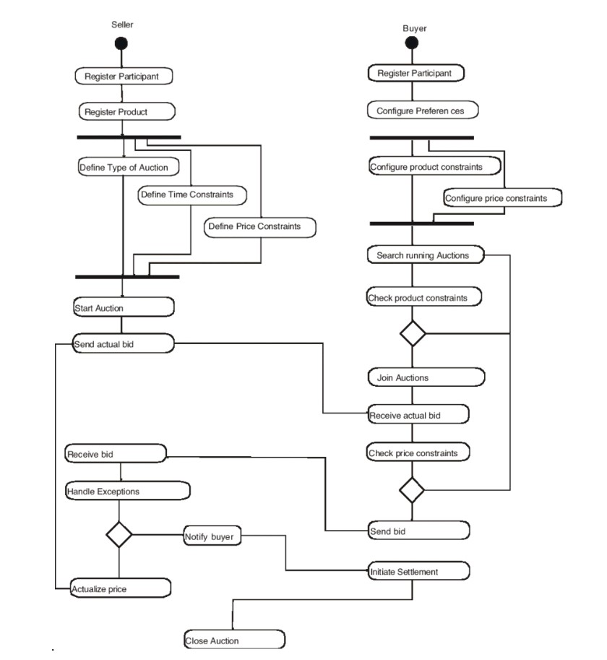
SYSTEM BLOCK DIAGRAM
Department of Computer Science & Engineering

Slide 10
IMPLEMENTATION
❑ The application area for our bidding solution extends to the real estate sector, serving as a centralized platform for buyers, sellers, and renters to engage in seamless and efficient property transactions.
❑ This solution caters to individuals and businesses involved in buying, selling, or renting residential and commercial properties. Whether it's a homeowner looking to sell, a buyer searching for their dream property, or someone in need of a rental.
❑Our bidding solution provides a convenient, transparent, and user-friendly space for all participants in the real estate market.
Department of Computer Science & Engineering

Slide 11
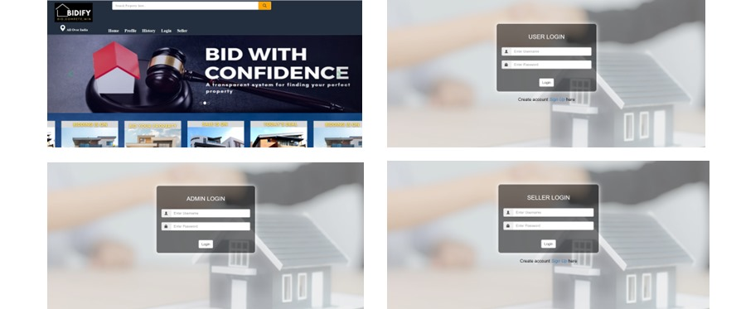
RESULT & DISCUSSION
Our competitive solutions offer a revolutionary approach to the real estate industry by optimizing real estate buying and renting transactions. Sellers post listings with customizable starting prices, allowing potential buyers or renters to make offers in real-time.
Department of Computer Science & Engineering

Slide 12
REQUIREMENT
SOFTWARE
BACKEND
PHP
STRUCTURED QUERY LANGUAGE
Database
FRONTEND
HTML
CSS
JavaScript
Bootstrap
Department of Computer Science & Engineering

Slide 13
REFERENCES
[1] White, R., & Lee, Ms. (2022). BidMaster. Auction Technologies Ltd.
[2] Patel, N., & Garcia Es (2021). Auctioneer Pro. Bidding Solutions Inc.
[3] Kim, Y., & Singh , Rs. year: (2023). BidsHub Elite. Elite Bidding Apps.
[4] Rodriguez, A., & Wu, Ys. year: (2024). QuickBid Connect. Tech Bids Co.
[5] Smith, L., & Nguyen, Qs. (2022). BidSync Expert. Sync Solutions LLC.
Department of Computer Science & Engineering

Slide 14
CONCLUSION
Dominate the bidding process with Bidify. Our streamlined platform keeps you informed, organized, and ready to place winning bids. Stay ahead of the competition with instant notifications and property insights. Don't just find your dream property, secure it with confidence. Download Bidify today and unlock the key to your real estate success.
Department of Computer Science & Engineering

Slide 15
Thank You!
Department of Computer Science & Engineering

